Slide 1

PySpark ALS Netflix Movie Recommendation System
This project builds a Netflix-style movie recommendation system using PySpark's ALS collaborative filtering. It processes user ratings and movie details from CSVs, trains an ALS model, and evaluates predictions with RMSE.
Key Features
Reads user ratings (CustId, MovieId, Rating) & movie details (MovieId, MovieTitle).
Generates top-10 movie recommendations per user.
Generates top-10 user recommendations per movie.
Robust Design
Includes proper type casting and null handling.
Implements cold-start strategy for new users/movies.
Outputs all results to HDFS as CSV files.

Slide 2
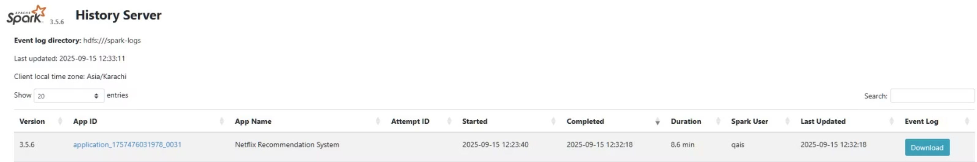
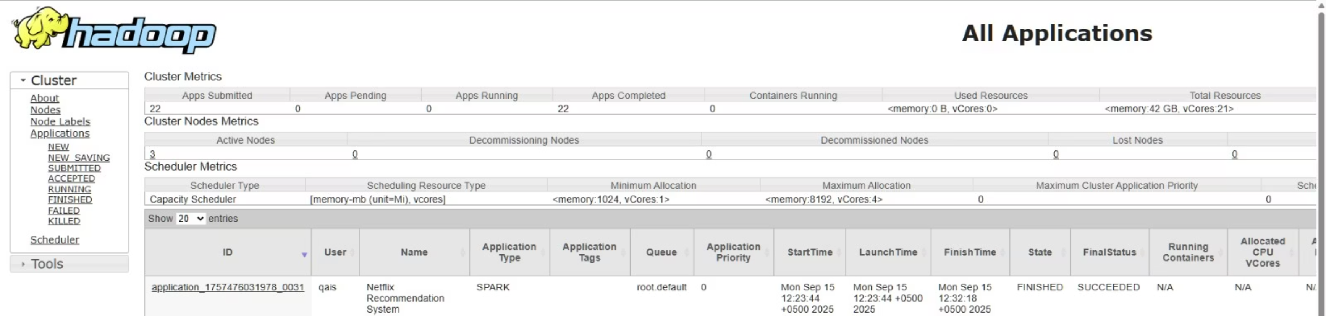
Spark
YARN

Slide 3
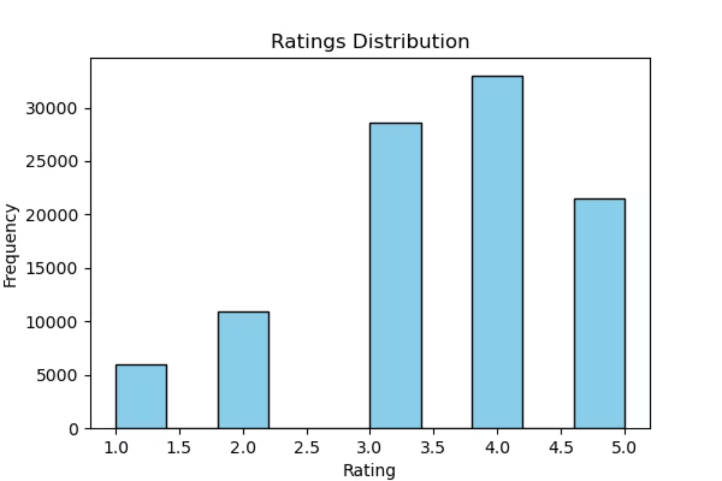
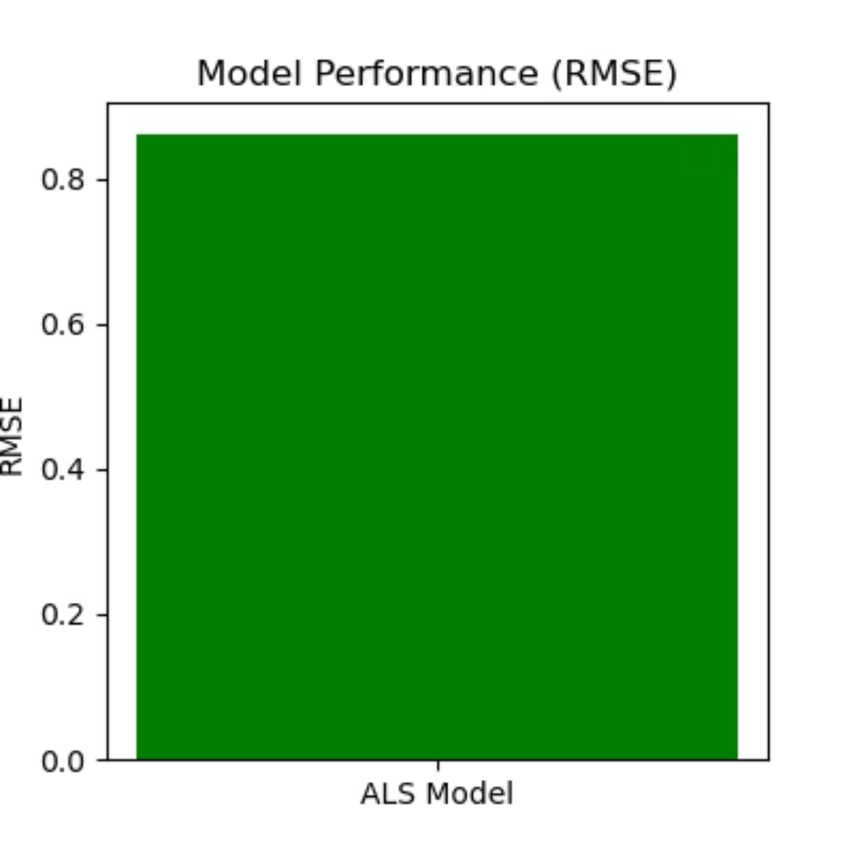
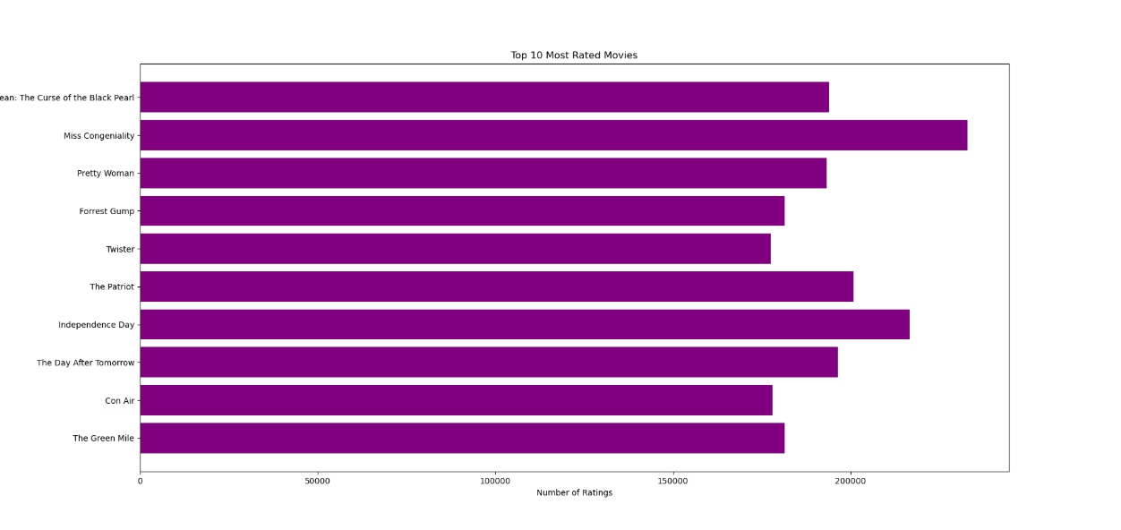
GRAPHS

